Slide 1
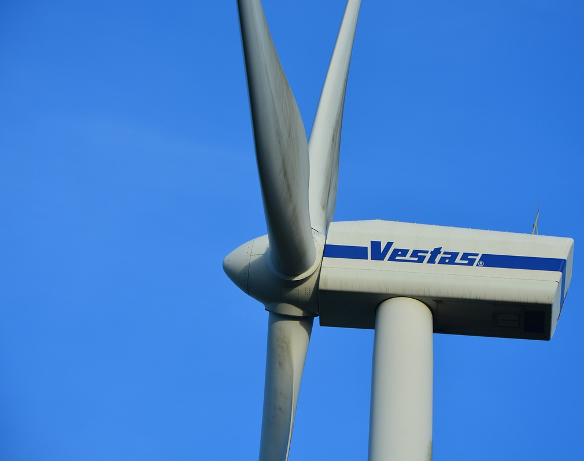
Maritime Wind Speed Prediction Using Buoy LIDAR Data
Team: Brian Waite, Carl Walenciak
Southern Methodist University
Time Series Analysis
Prof. B. Sadler

Slide 2
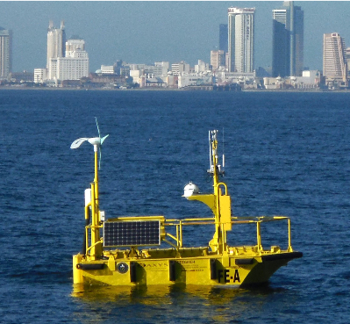
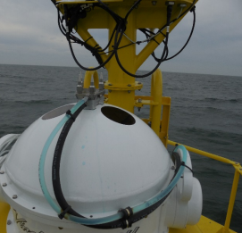
What is Buoy LIDAR Data?
Pacific Northwest National Labs (PNNL) in support of U.S. Department of Energy (DOE)
Buoy collects comprehensive meteorological and oceanographic data characterize offshore wind energy.
LIDAR – LIght Detection And Ranging
Using Data from April 2016 buoy deployment. (Specifically 01-20 April)
https://wind.pnnl.gov/lidarbuoyloanprogram.asp
https://wind.pnnl.gov/pdf/Example_Monthly_Report.pdf

Slide 3
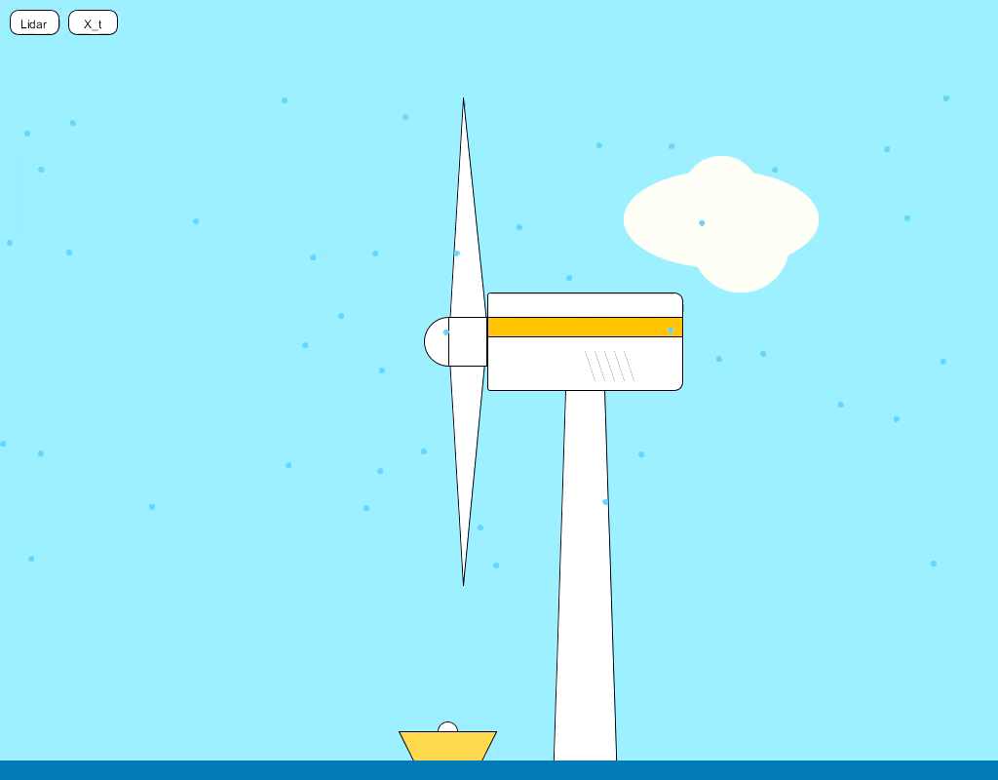

Slide 4
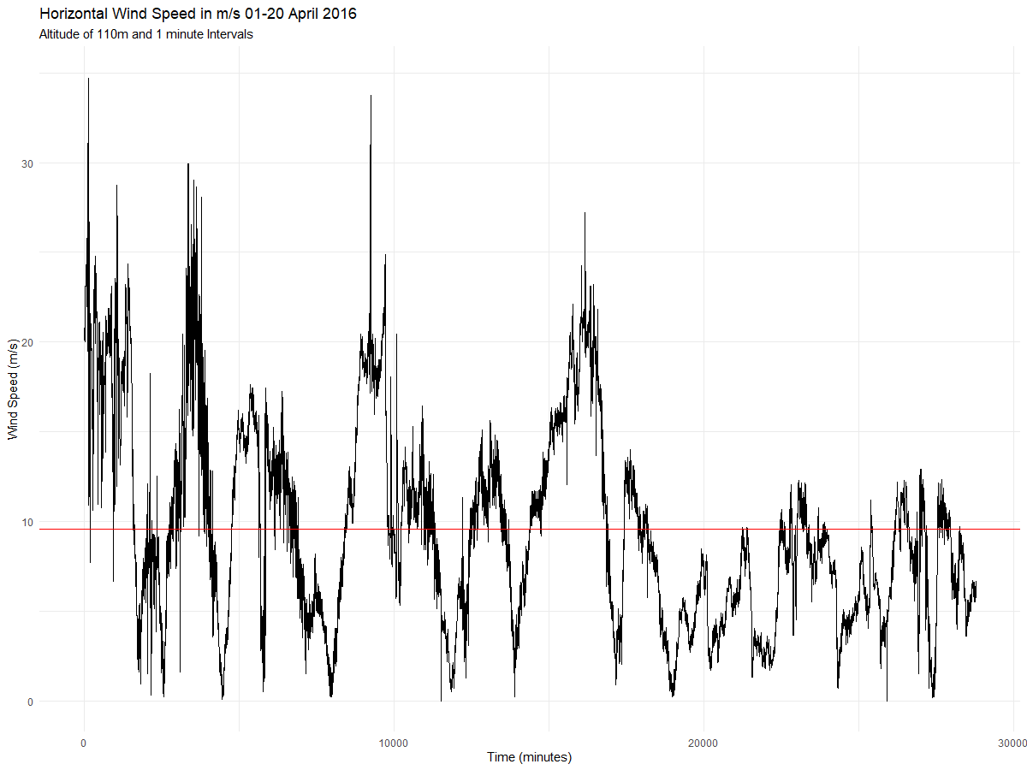
Realization
X_{bar}
But what does it mean?

Slide 5
